Slide 1
FACT assessment balances AI-assisted learning and traditional assessment
A
Authentic Project
Open AI use
Create
Evaluate
Analyze
Apply
Understand
Remember
T
Critical Thinking
Structured AI use
F
Fundamental Skills
AI resistant assignments
Conceptual Understanding
C
No AI use
Elshall and Badir (2025)
Notes:
We need to integrate GenAI to STEM and non-STEM education to response to
rising employer demand for AI skills
broader workforce shift toward automation
How to assess students?
FACT assessment maps Bloom’s taxonomy
With scaffolded AI use

Slide 2
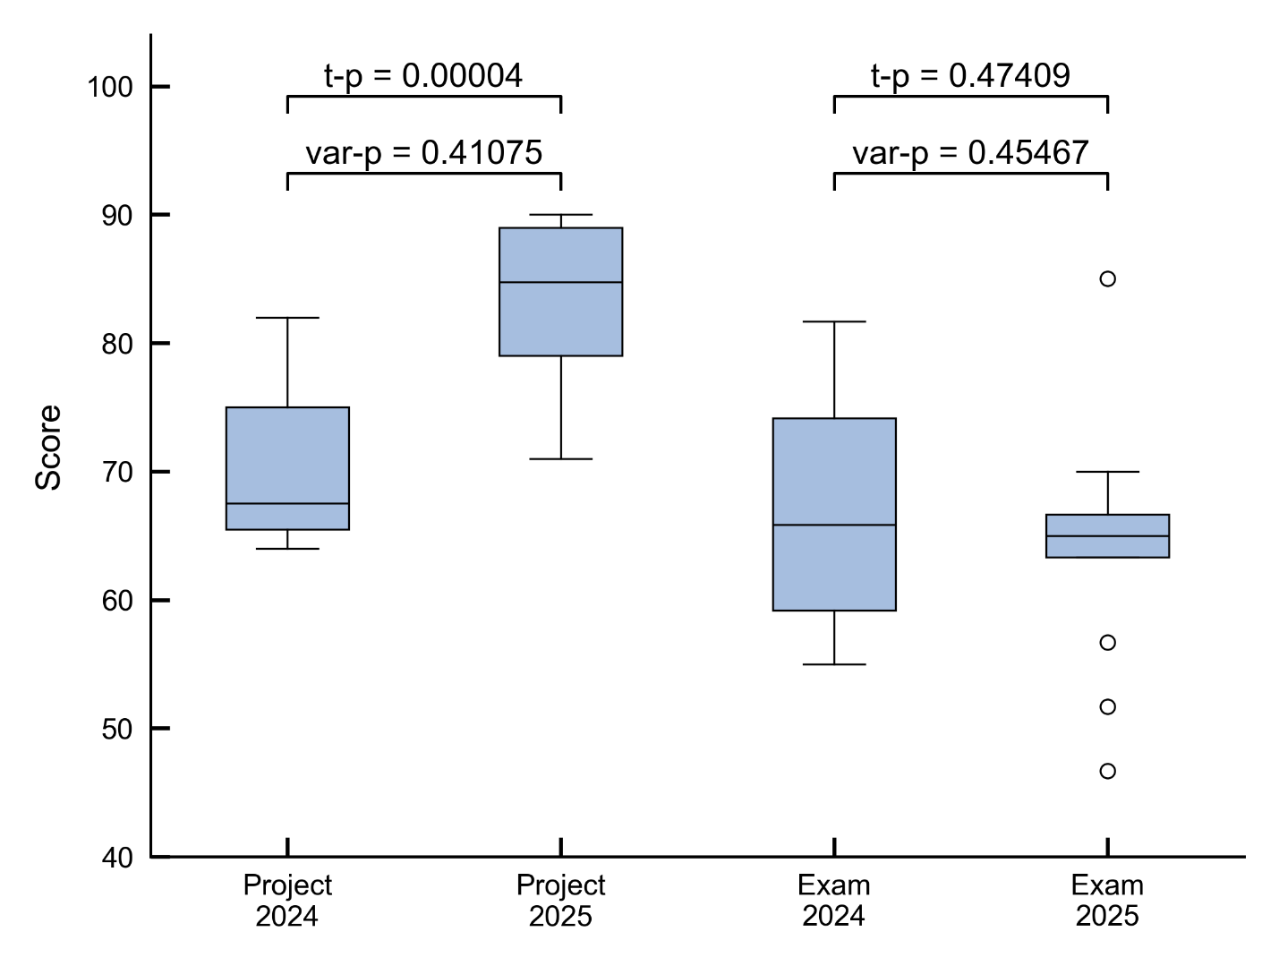
AI upgrade led to improved applied performance without causing foundational knowledge to erode
Elshall et al. In Review

Slide 3
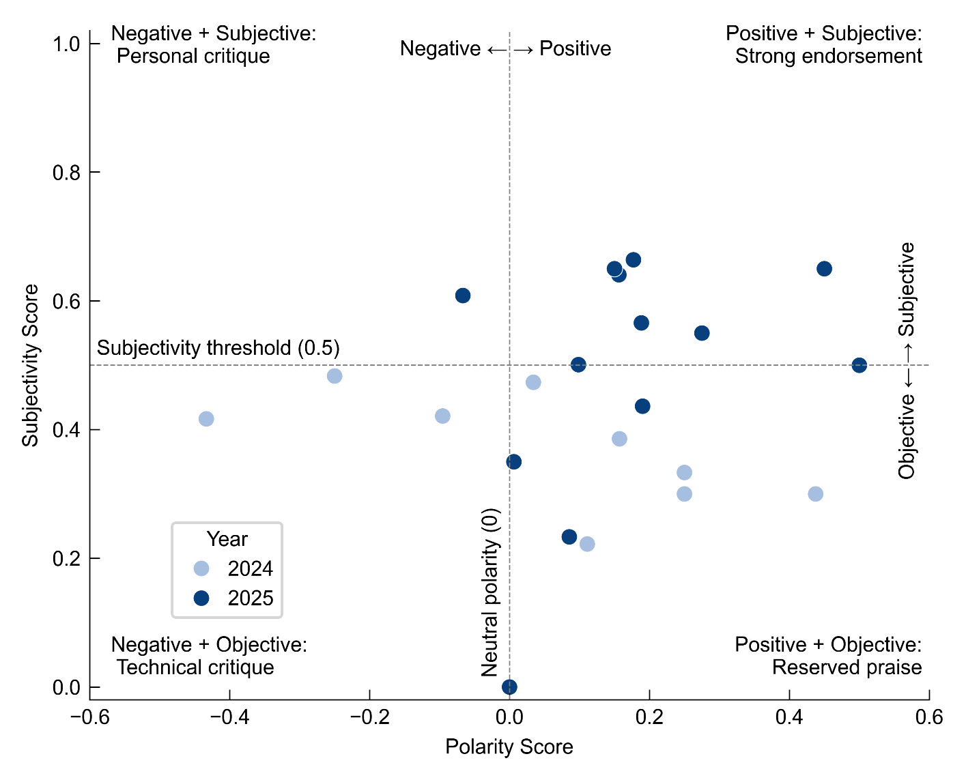
AI upgrade shifted help seeking from peer-dependent to autonomous and empowered students
Elshall et al. In Review
Notes:
a shift from peer-dependent to autonomous help seeking and increased positive sentiment toward AI support.
This migration indicates growing enthusiasm and ownership of AI tools.

Slide 4







AI upgrades will improve learning when paired with effective pedagogical design
Process Transparency
Hybrid Assessment Design
Scaffolded AI Use
Active Instructor Mentoring
Instructor Metacognitive Modeling
Student Metacognitive Reflection
Mandated Instructor Checkpoints
Early Warning System
Elshall et al. In Review
Notes:
Course structure: Scaffolded AI integration
Assessment method: Hybrid assessment design
Support mechanism: Mandated instructor checkpoints
Cultural foundation: Process transparency
Instructor role: Metacognitive modeling
Target skill: Metacognitive reflection
Student monitoring: Early warning system
Active instructor mentoring

Slide 5
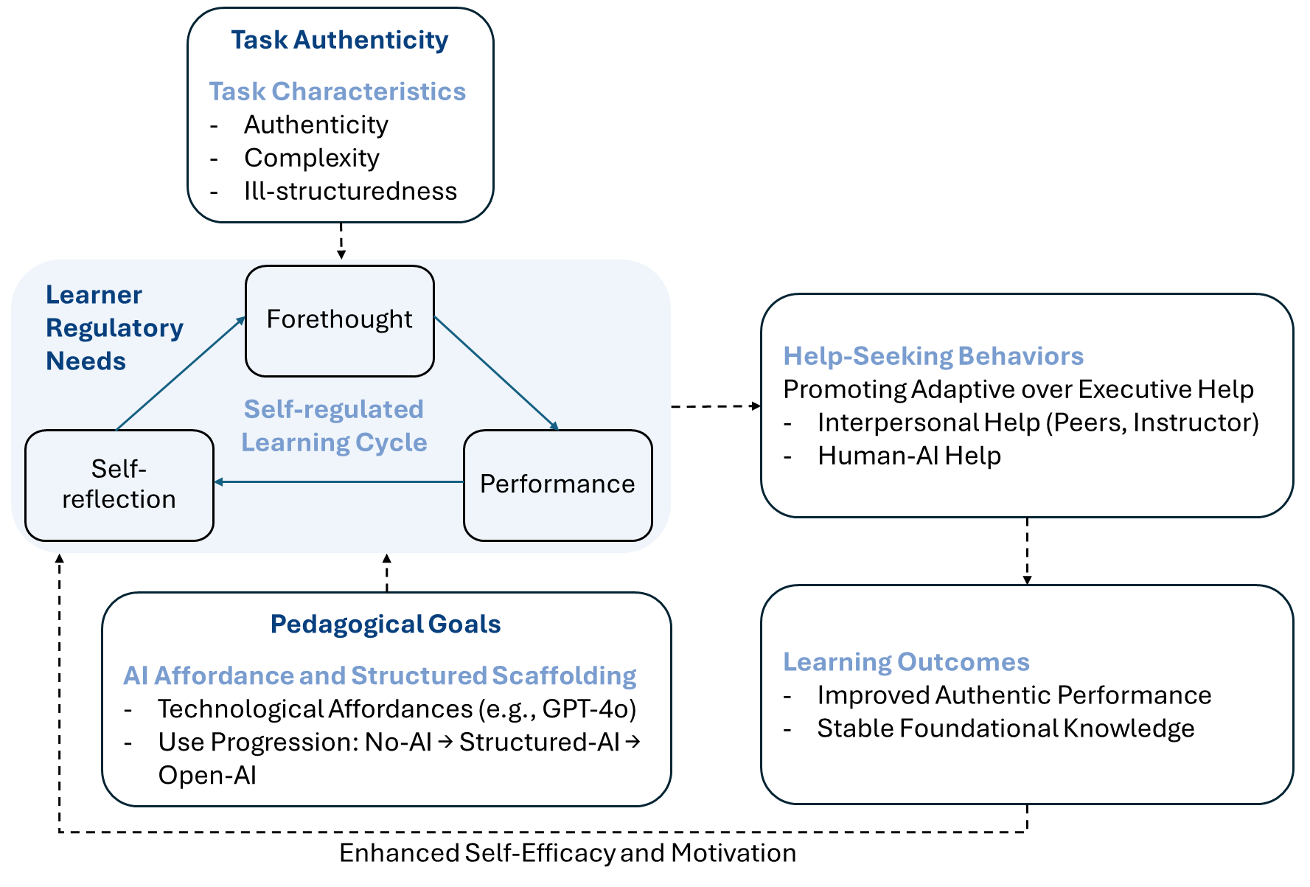

Is summary, matching AI affordances with task authenticity, pedagogical goals, and learner regulatory needs influences help-seeking behaviors and can improve learning outcomes
Questions?
Notes:
Figure 1. The AI-affordance alignment framework where matching AI affordances with task authenticity, pedagogical goals, and learner regulatory needs influences help-seeking behaviors and improves learning outcomes.

